Slide 1

Software Design and Arcitecture(SDA) Lecture 2
Engr.Ramsha Mashood
Senior Lecturer
Department of Software Engineering
Bahria University Karachi Campus

Slide 2




Design principles; Object-Oriented Design with UML

Slide 3
TEXT BOOK
Object-Oriented Analysis, Design and Implementation, Brahma Dathan, Sarnath Ramnath, Latest Edition, Universities Press

Slide 4
REFERENCE BOOK
2. Software Engineering: A Practitioner’s Approach, Roger S. Pressman, Bruce R. Maxim, 8th Ed, McGraw-Hill Education, 2015. 3.
3. Essential Software Architecture, Gorton I., latest Edition, Springer – Verlag

Slide 5

SOFTWARE DESIGN PRINCIPLE
Software design principles are concerned with providing means to handle the complexity of the design process effectively. Effectively managing the complexity will not only reduce the effort needed for design but can also reduce the scope of introducing errors during design.

Slide 6
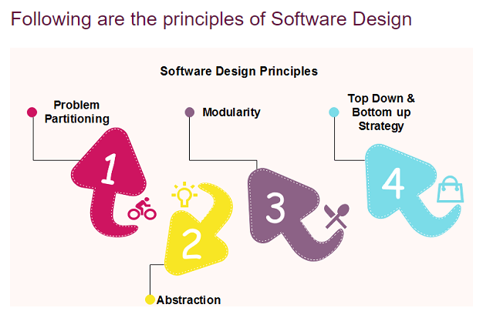

Slide 7
Problem Partitioning
For small problem, we can handle the entire problem at once but for the significant problem, divide the problems and conquer the problem it means to divide the problem into smaller pieces so that each piece can be captured separately.
As the number of partition increases = Cost of partition and complexity increases
Abstraction
An abstraction is a tool that enables a designer to consider a component at an abstract level without bothering about the internal details of the implementation. Abstraction can be used for existing element as well as the component being designed.
Here, there are two common abstraction mechanisms
Functional Abstraction
Data Abstraction

Slide 8
Modularity
Modularity specifies to the division of software into separate modules which are differently named and addressed and are integrated later in to obtain the completely functional software. It is the only property that allows a program to be intellectually manageable. Single large programs are difficult to understand and read due to many reference variables, control paths, global variables, etc.
Strategy of Design
A good system design strategy is to organize the program modules in such a method that are easy to develop and latter too, change. Structured design methods help developers to deal with the size and complexity of programs. To design a system, there are two possible approaches:
Top-down Approach
Bottom-up Approach

Slide 9
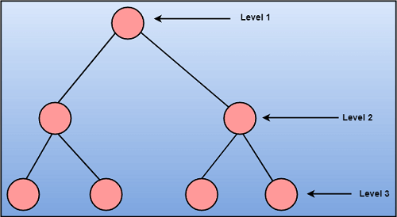
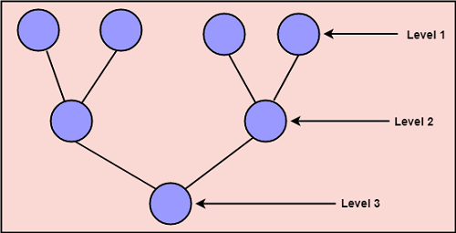
Top-down Approach: This approach starts with the identification of the main components and then decomposing them into their more detailed sub-components.
Bottom-up Approach: A bottom-up approach begins with the lower details and moves towards up the hierarchy, as shown in fig. This approach is suitable in case of an existing system.

Slide 10
SOLID Principles:
Single Responsibility Principle (SRP): A class should have only one reason to change, meaning it should have only one responsibility or job.
Open/Closed Principle (OCP): Software entities (classes, modules, functions) should be open for extension but closed for modification.
Liskov Substitution Principle (LSP): Subtypes should be substitutable for their base types without altering the correctness of the program.
Interface Segregation Principle (ISP): A class should not be forced to implement interfaces it does not use. Instead of having large, monolithic interfaces, use smaller, specific ones.
Dependency Inversion Principle (DIP): High-level modules should not depend on low-level modules. Both should depend on abstractions. Abstractions should not depend on details; details should depend on abstractions.

Slide 11
What is modeling?
Modeling consists of building an abstraction of reality.
Abstractions are simplifications because:
They ignore irrelevant details and
They only represent the relevant details.
What is relevant or irrelevant depends on the purpose of the model.

Slide 12
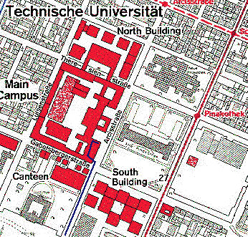
Example: street map
Example

Slide 13
Why model software?
Why model software?
Software is getting increasingly more complex
Windows XP > 40 mio lines of code
A single programmer cannot manage this amount of code in its entirety.
Code is not easily understandable by developers who did not write it
We need simpler representations for complex systems
Modeling is a mean for dealing with complexity

Slide 14
Systems, Models and Views
A model is an abstraction describing a subset of a system
A view depicts selected aspects of a model
A notation is a set of graphical or textual rules for depicting views
Views and models of a single system may overlap each other
Examples:
System: Aircraft
Models: Flight simulator, scale model
Views: All blueprints, electrical wiring, fuel system

Slide 15
Systems, Models and Views
Flightsimulator
Blueprints
Aircraft
Electrical
Wiring
Scale Model

Slide 16
Models, Views and Systems (UML)
*
*
System
Model
View
Described by
Depicted by
Airplane: System
Scale Model: Model
Flight Simulator: Model
Blueprints: View
Fuel System: View
Electrical Wiring: View

Slide 17
What is UML?
A UML diagram is a partial graphical representation (view) of a model of a system under design, implementation, or already in existence. UML diagram contains graphical elements (symbols) - UML nodes connected with edges (also known as paths or flows) - that represent elements in the UML model of the designed system.
The UML model of the system might also contain other documentation such as use cases written as templated texts..
Supported by several CASE tools
Rational ROSE
TogetherJ

Slide 18
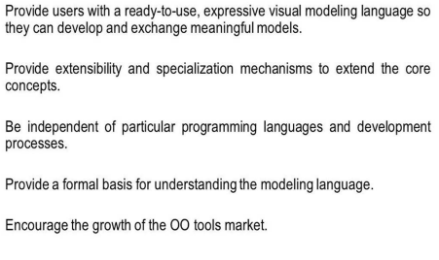
Goals of uml

Slide 19
Why we use Uml
Using UML (Unified Modeling Language) offers several advantages in software development:
Visualization and Clarity:
UML provides a visual representation of a software system, making it easier for stakeholders to understand and discuss complex structures, relationships, and processes.
Communication and Collaboration:
UML serves as a standardized language that facilitates effective communication among team members and stakeholders with diverse backgrounds. It promotes collaboration by providing a common understanding of the system.
Analysis and Design:
UML supports both the analysis and design phases of software development. It helps in modeling the problem domain during analysis and provides a basis for creating detailed specifications and designs during the design phase.

Slide 20
Why we use Uml
Consistency and Documentation:
UML enables the creation of consistent and comprehensive documentation for a software system. This documentation is not only useful for developers but also serves as a valuable resource for future maintenance and enhancements.
Model-Code Consistency:
UML tools often allow for code generation, ensuring consistency between the design models and the actual implementation. This reduces the risk of discrepancies between the intended design and the implemented code.
In summary, using UML enhances communication, promotes clarity, and provides a standardized approach to software modeling, contributing to the overall success of a software development project.

Slide 21
Types of classification
UML specification defines two major kinds of UML diagram:
structure diagrams and behavior diagrams.
Structure diagrams show the static structure of the system and its parts on different abstraction and implementation levels and how they are related to each other. The elements in a structure diagram represent the meaningful concepts of a system, and may include abstract, real world and implementation concepts.
Behavior diagrams show the dynamic behavior of the objects in a system, which can be described as a series of changes to the system over time.
UML 2.5 diagrams could be categorized hierarchically as shown below. Note, items shown in blue are not part of official UML 2.5 taxonomy of diagrams.

Slide 22
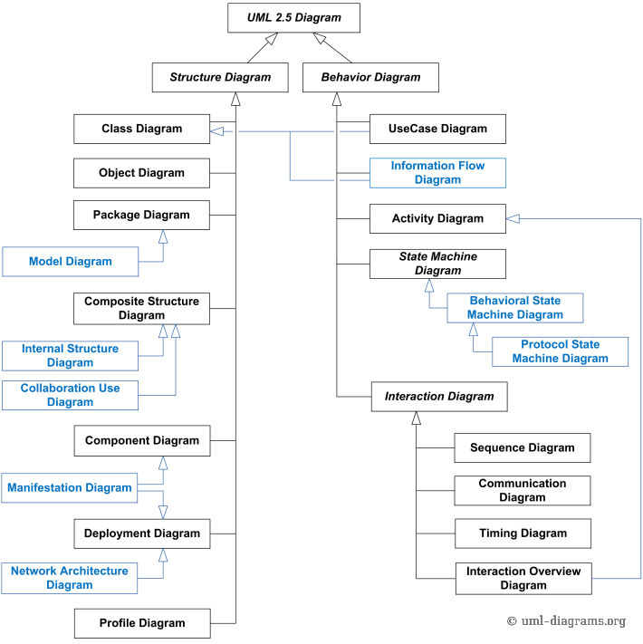

Slide 23
Structure UML
Class Diagrams:
Class diagrams depict the static structure of a system by showing classes, their attributes, methods, and relationships. They are widely used for visualizing the overall architecture of a software system.
Object Diagrams:
Object diagrams represent instances of classes and the relationships between these instances at a specific point in time. They provide a snapshot of the system's structure during runtime.
Package Diagrams:
Package diagrams show the organization and dependencies among packages in a system. They help in organizing and managing large-scale systems by grouping related elements into packages.

Slide 24
Structure UML
Component Diagrams:
Component diagrams represent the physical components (e.g., executable files, libraries) of a system and their relationships. They focus on the organization and dependencies of these components.
Composite Structure Diagrams:
Composite structure diagrams illustrate the internal structure of a class or component, showing how parts and ports are interconnected. They provide a detailed view of the collaboration within a complex structure.
Deployment Diagrams:
Deployment diagrams model the physical deployment of software components to hardware nodes. They show how software artifacts are distributed across different nodes in a network.

Slide 25
Behavioral UML
Use Case Diagrams:
Use case diagrams depict the interactions between a system and its external actors. They illustrate the various use cases and their relationships, providing a high-level view of system functionality from a user's perspective.
Sequence Diagrams:
Sequence diagrams show the interactions between different objects or components over time. They depict the order in which messages are exchanged between objects, helping to visualize the dynamic behavior of a system during a specific scenario or operation.
Collaboration Diagrams (Communication Diagrams):
Collaboration diagrams focus on the interactions and collaborations between objects. They emphasize the structural organization of objects and the messages exchanged among them.

Slide 26
Behavioral UML
Activity Diagrams:
Activity diagrams model the workflow or flow of activities within a system. They are used to represent the dynamic aspects of a system, including actions, decisions, and concurrency.
State Machine Diagrams:
State machine diagrams depict the states that an object or system can be in and the transitions between these states. They are particularly useful for modeling the behavior of objects that undergo different states in response to events.
Interaction Overview Diagrams:
Interaction overview diagrams provide an overview of the interactions between different elements in a system. They combine elements of activity diagrams and sequence diagrams to represent the flow of control between various activities.
Timing Diagrams:
Timing diagrams focus on the timing constraints and interactions between objects in a system. They represent the timing of messages and events over a specific period, helping to visualize the temporal aspects of a system.

Slide 27
UML first pass: Use case diagrams
Package
Use case
Watch
Actor
ReadTime
WatchUser
SetTime
WatchRepairPerson
ChangeBattery
Use case diagrams represent the functionality of the system
from user’s point of view

Slide 28
UML first pass: Class diagrams
Association
Class
Multiplicity
Watch
1
1
1
1
2
1
2
1
PushButton
LCDDisplay
Battery
load
Time
now
state
blinkIdx
blinkSeconds()
blinkMinutes()
blinkHours()
stopBlinking()
referesh()
push() release()
Attribute
Operations

Slide 29
UML first pass: Sequence diagram
Actor
Object
:WatchUser
:Watch
:LCDDisplay
:Time
pressButton1()
blinkHours()
pressButton1()
blinkMinutes()
Message
pressButton2()
incrementMinutes()
refresh()
pressButtons1And2()
commitNewTime()
stopBlinking()
Activation
Lifeline
Sequence diagrams represent the behavior as interactions

Slide 30
UML first pass: Statechart diagrams for objects with interesting dynamic behavior
State
Event
Initial state
Transition
Final state
Represent behavior as states and transitions

Slide 31
Some links
https://www.uml-diagrams.org/uml-25-diagrams.html
https://www.lucidchart.com/pages/what-is-UML-unified-modeling-language/#section_0

Slide 32
Any thing to ask ??

